Slide 1
Mac Operating System
The Macintosh Operating System (Mac OS) is an operating system (OS) designed by Apple Inc. to be installed and operated on the Apple Macintosh series of computers. Introduced in 1984, it is a graphical user interface (GUI) based OS that has since been released as multiple different versions.
Mac OS is designed to operate on Apple manufactured PCs and by default, does not support x86 architecture.
As of 2012, Mac OS released several versions, including Macintosh 128k, Mac OS 7, Mac OS X and Mac Mountain Lion.

Slide 2
Design Principles
Pre-emptive multitasking and memory protection.
Designed to be portable.
Includes its own software development tools , most , most prominently an integrated development environment called Xcode. Xcode provides interfaces to compilers that support several programming languages including C, C++, Objective-C, and Java.

Slide 3
Design Principles
To permit a smooth transition from Mac OS 9 to Mac OS X, the Carbon Application Programming Interface Carbon Application Programming Interface (API) was (API) created. Applications written with Carbon can be executed natively on both systems.
Support the Java Platform as a "preferred software package"—in practice this means that applications written in Java fit as neatly into the operating system as possible while still being cross-platform compatible.
Many software packages written for the BSDs or Linux can be recompiled to run on it.

Slide 4
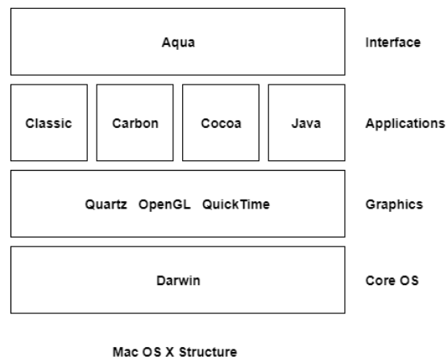
System Component
The structure of the Mac OS X includes multiple layers.
The base layer is Darwin which is the Unix core of the system.
Next layer is the graphics system which contains Quartz, OpenGL and QuickTime.
Then is the application layer which has four components, namely Classic, Carbon, Cocoa and Java.

Slide 5
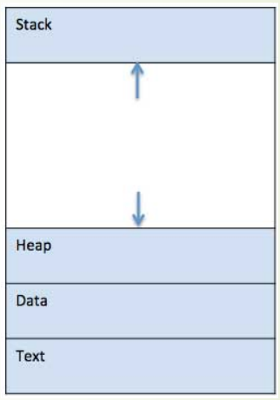
Process in Mac OS X
A process is basically a program in execution.
The execution of a process must progress in a sequential fashion.
When a program is loaded into the memory and it becomes a process.
It can be divided into four sections stack, heap, text and data.

Slide 6
Processor Modes
Supervisor Mode – allows execution of privileged instructions and access to privileged registers
User Mode - The processor mode that forbids execution of privileged instructions and access to privileged registers. Any attempt to do so will result in a privilege violation exception.

Slide 7
Process States
SIDL: Process is partially created
SRUN: Process is runnable
SSLEEP: Process is awaiting event
SSTOP: Process is stopped (by signal or parent process)
SZOMB: Process is partially terminated.(waiting for parent process to collect status)

Slide 8
Process Scheduling
Marriage of FreeBSD and Mach
Uses a priority scheduling algorithm combined with a time quantum
Priorities are stored in the PCB and range from -20 to 20 with higher values indicating lower level priority
“Pzero” refers to a priority variable of 0
Reschedules every tenth of a second and recomputes priorities once every second

Slide 9
Process Scheduling
No preemption in Mac OS X scheduling
Task will relinquish CPU after time quantum or when it must wait for an I/O completion
Process feedback – priorities change dynamically based on wait time and amount of time that the process has had the processor
Feedback prevents starvation

Slide 10
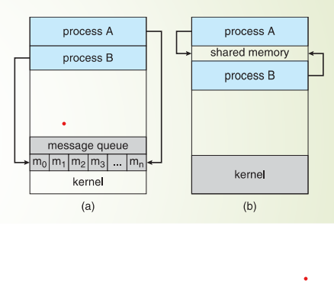
Interprocess Communication in Mac X
For fast exchange of information, cooperating processes need some interposes communication (IPC) mechanisms.
Two models of IPC.
Shared memory
Message passing

Slide 11
Thread Management in Mac OS
Each process (application) in OS X or iOS is made up of one or more threads.
Every application starts with a single thread
Each thread has its own execution stack and is scheduled for runtime separately by the kernel.
A thread can communicate with other threads and other processes.
perform I/O operations, and do anything else you might need it to do.

Slide 12
Thread management in Mac OS
All threads in a single application share the same virtual memory space and have the same access rights as the process itself. Because they are inside the same process space.
Thread Costs in Mac OS X:
Threading has a real cost to your program (and the system) in terms of memory use and performance.
Each thread requires the allocation of memory in both the kernel memory space and your program’s memory space.

Slide 13
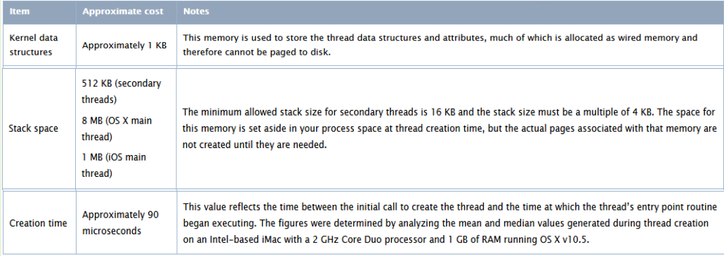
Thread Creation costs

Slide 14
User Threads and Kernel Threads in Mac OS
User threads:
-Support provided at the user-level
-Management is done by thread library
Kernel threads
-Supported and managed by OS
-Virtually all modern general-purpose operating systems

Slide 15
Memory Management
5 Basic Mach Abstractions
Task
Thread
Port
Message
Memory Object
Basic VM Operations
allocate a region of virtual memory on a page boundary,
deallocate a region of virtual memory,
set the protection status of a region of virtual memory,
specify the inheritance of a region of virtual memory .

Slide 16
Memory Management
Four basic memory management data structures are used in Mach:
the resident page table - a table used to keep track of information about machine independent pages
2. the address map - a doubly linked list of map entries, each of which describes a mapping from a range of addresses to a region of a memory object
3. the memory object - a unit of backing storage managed by the kernel or a user task.
4. the pmap - a machine dependent memory mapping data structure (i.e., a hardware defined physical address map).

Slide 17
File Management
File related system calls
Virtual File System (VFS)
The Darwin kernel implements a Virtual File System (VFS) that translates a file-related system call into the matching call for the appropriate file system.
UFS
HFS+
NFS
UDP
Disk
Network

Slide 18
Advantages of Mac OS
Easy to Use
The Mac OS is much easier to ease than any other operating system. Even people who are not familiar with it can operate it easily.
Integration With Apple and Other Products
Mac OS will automatically recognize and work with any other Apple product, such as iPhone, Cinema Display, Airport, and iPad. On top of this, additional drivers are rarely needed for non-Apple products.
Mac OS can run Windows at the same time
Mac OS runs on Intel chips, which means you can run XP or Vista concurrently with Mac OS, with Boot Camp or Parallels software.

Slide 19
Advantages of Mac OS
Reliability
Because OS X was designed from scratch from the ground up,Mac OS is incredibly stable.Apple controls production from start to finish , so every part of a mac is desiged and tested to work together.
Design
It’s engineered to take full advantage of what the hardware is capable of.And it’s designed to deliver the most intuitive and intregrated computer experience in the world.

Slide 20
Disadvantages of Mac OS
Gaming
If you are a computer gamer,mac OS is’nt going to do it for you.Boot camp and parallels will allow you to run games natively in windows,but there may be a performane hit.Some games are produced for Mac OS,but the number is very small .
Price
All that flashy secure reliable power comes at a price.Macs cost more than machines that run other operating systems.The result is you’re paying to premium to have what is often the highest-end hardware on the market.

